Slide 1
V Gravity
By Catani

Slide 2
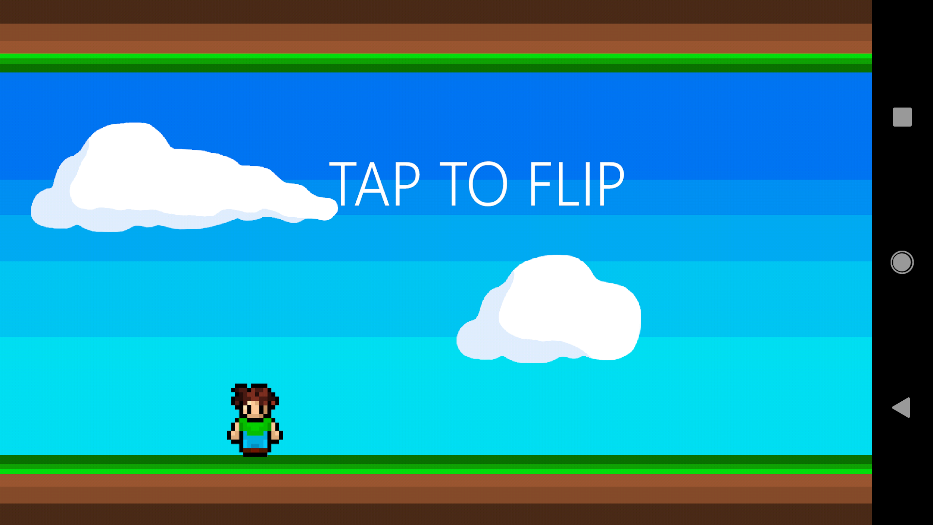
(Shoutout to Gravity Guy and VVVVVV)
VGravity
Designed specifically for android

Slide 3
Release Schedule
1.0 | Scrolling background and ability to flip gravity
2.0 | Scrolling obstacles with hit detection
3.0 | Add larger variety of obstacles such as pitfalls and spawn obstacles with increasing difficulty for the player as score progresses
3.5 | Add coin with random spawn locations
4.0 | Develop Main Menu and Gameover screen that transition into one another as well as Game screen
4.5 | Add dynamic score in meters and speed up scrolling background as game progresses
5.0 | Add complex obstacle spawning. Having only one obstacles spawn at one time.
6.0 | Attempt cloud based score and possible multiplayer on android devices

Slide 4
New Techniques
1
Programming techniques learned out of class

Slide 5
The Game Level
The game controls everything
All created objects were moved to the game level if possible
There is only one instance of objects that are at the game level at all times
All classes grab the objects that are at the game level using “game.object”
This makes the program more efficient as we do not need to create a new instance of the object at every screen

Slide 6
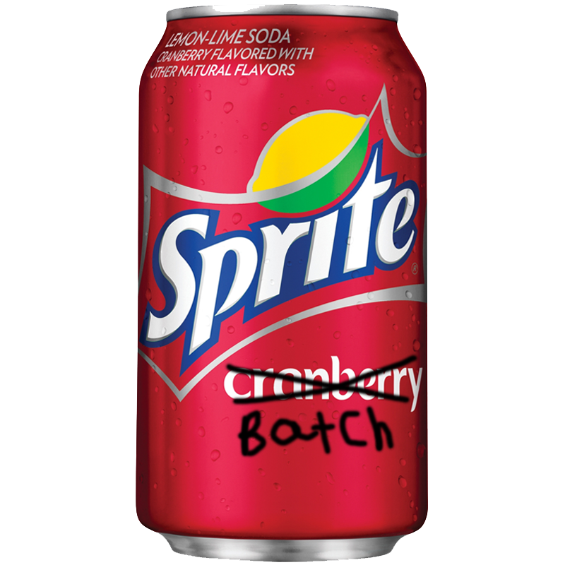
The Game Level (Example)
Step 1: public class GamGravity extends Game {
public SpriteBatch batch;
Step 2: public class ScrMainMenu implements Screen {
GamGravity game;
Step 3: public ScrMainMenu(GamGravity _game) {
this.game = _game;
Step 4: game.batch.begin();
game.batch.draw(texture)
game.batch.end();

Slide 7
Biggest Frustrations
2
What caused us to rage quit
💢

Slide 8
Character Animation
The character’s x and y position would change even though the image doesn't move visually.
The character’s getHeight and getWidth would get the dimensions of the whole spritesheet instead of the individual frame
A lot of trouble getting the image to flip upside down and right side up

Slide 9
New Programming:
Firebase
3
Learning how to integrate firebase into a Libgdx project
🔥

Slide 10
What is Firebase?
Cloud based development platform for mobile and web based applications
Used for databases, user management, and analytics

Slide 11
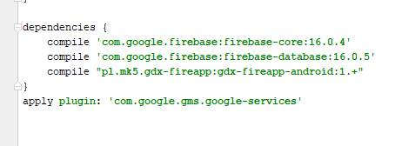
Setup & Dependencies
Create firebase account and setup project using firebase assistant
Add gdx-fireapp library

Slide 12
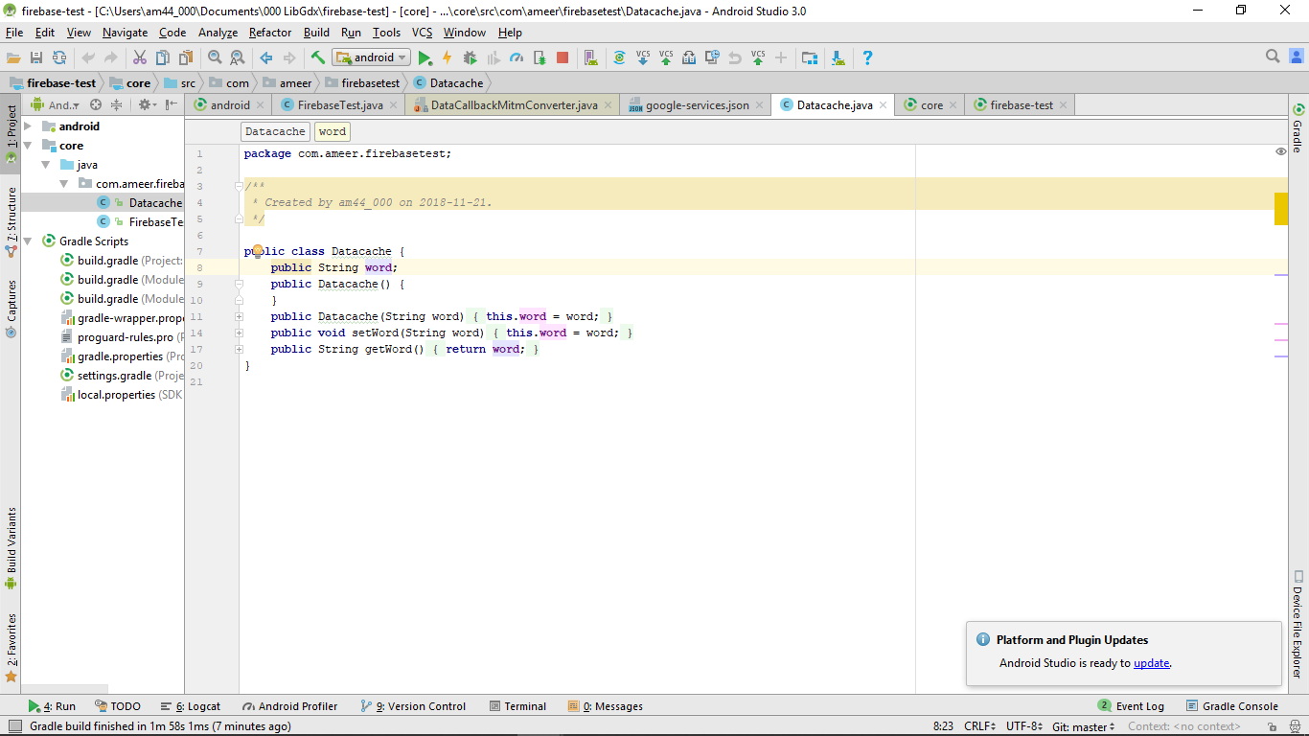
Implementing FIrebase
Create POJO class to interact with Firebase
Must use Strings!!

Slide 13
Implementing Firebase Cont.
Getting and Setting Database Values

Slide 14
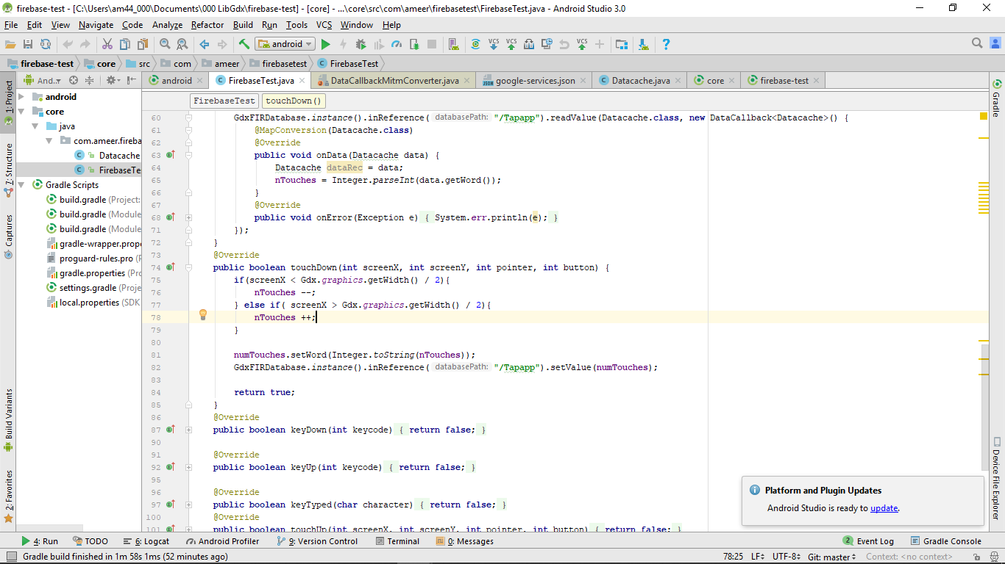
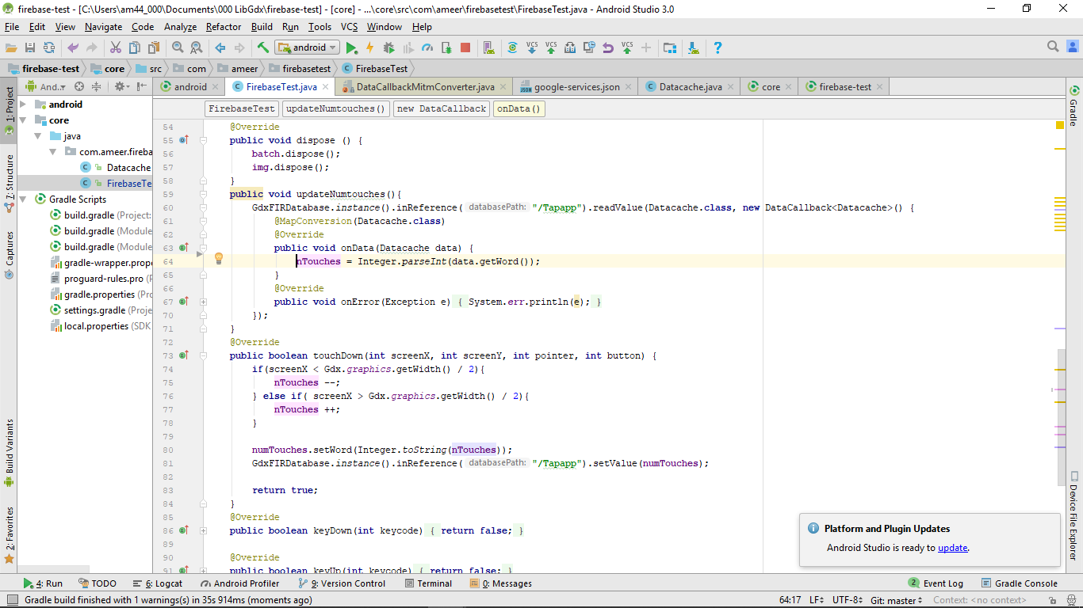

Slide 15
Object Overview
4
The architecture we used to create objects

Slide 16
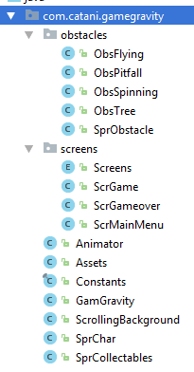
Obstacles
Screens
Various Classes

Slide 17
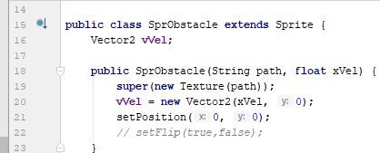
Obstacle Overview
SprObstacle Methods
Render
isHit
reDraw

Slide 18
Obstacle Overview
SprObstacle
ObsFlying
ObsSpinning
ObsPitfall
ObsTree

Slide 19
Known Bugs
🐞
5
What we can’t figure out
🐛

Slide 20
Major Lag Spikes
The will lag constantly, the lag is visible but does not disrupt gameplay
Every once in a while the game will lag intensely for a few seconds making the game unplayable
The reason for these lag spikes are unknown, even after observing processing power and memory usage of the app in its active state

Slide 21
What We Are Proud Of
6
What the people after us will need to know

Slide 22
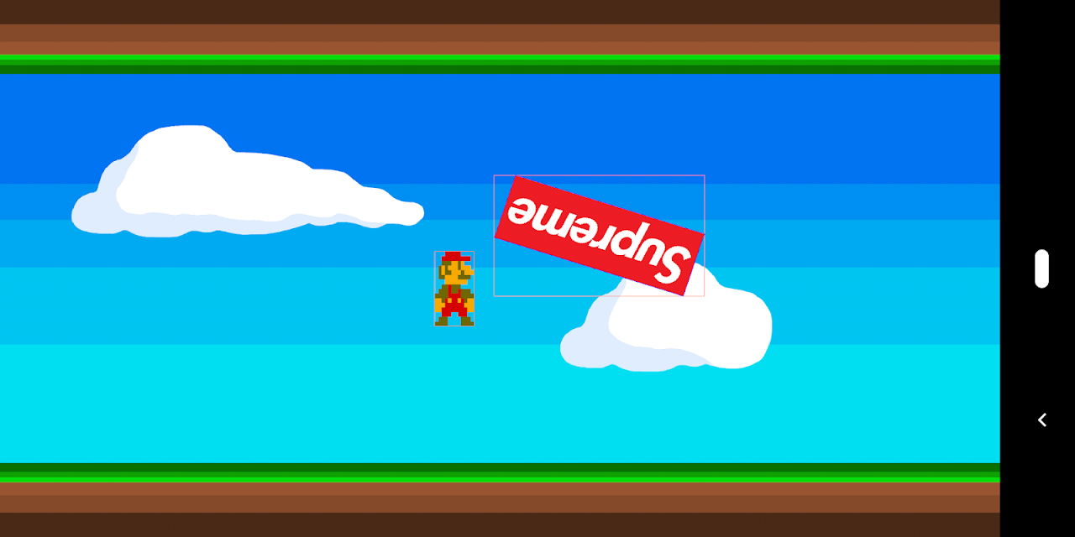
Polygon Hit Detection

Slide 23
Notes To Future Programmers
7
What the people after us will need to know

Slide 24
Expand on Collectables Class
Assure that the coin will not spawn over an obstacle
Add a wider variety of collectables (powerups, more valuable coins, etc.)
Add a balanced and more random spawn rate

Slide 25
Update The Background
Create and add different biomes
Program so that the ground and the ceiling are uneven (hills, valleys, etc.)

Slide 26

Fix Obstacle Spawning
Redesign the architecture for the obstacle spawning

Slide 27
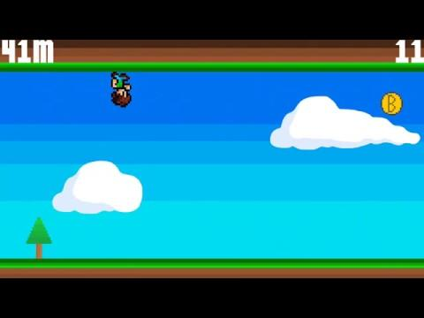

Slide 28
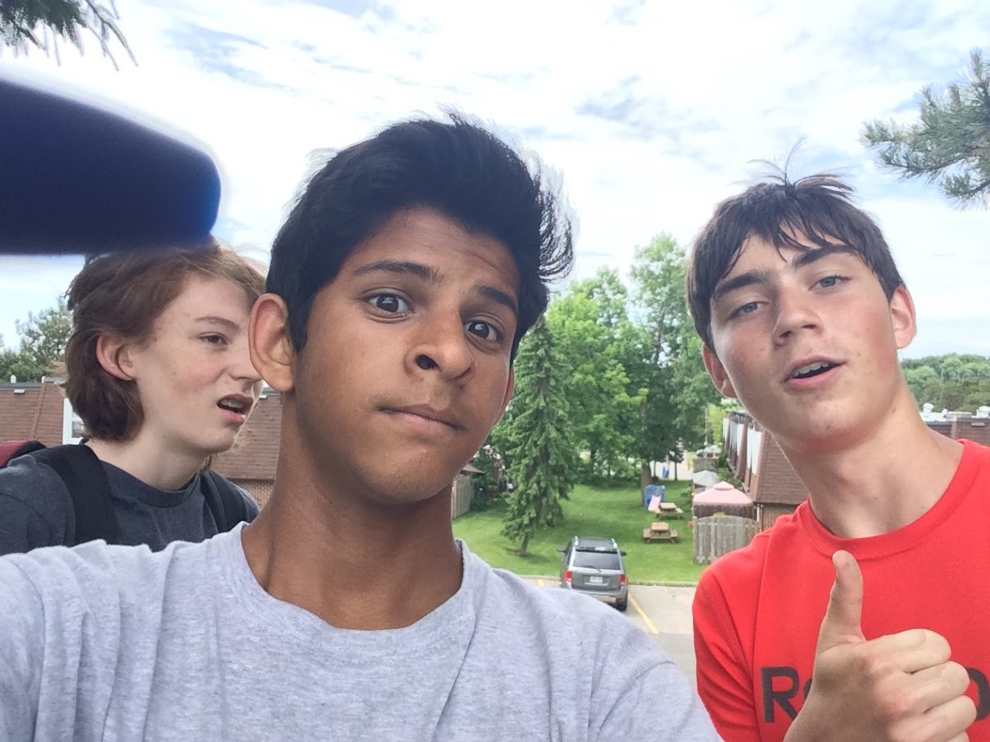
Thanks!
Joel was here

